Slide 1



DVRT
ASSIGNMENT
By : Jayden Tee Rong Qing

Slide 2

THE BUSINESS PROBLEM
The Operational Pain Points
The Business Consequences
  Data Isolation (Silos): Supply data (Stocks) and Demand data (Sales) live in disconnected files.
  Manual Latency: Management relies on slow, manual cross-referencing (Excel) to match orders with inventory.
  Reactive vs. Proactive: Decisions are made after problems occur, not predicted beforehand.
  Revenue Leakage (Stockouts): High-demand items go out of stock unnoticed, leading to lost sales.
  Capital Lock-up (Aging Inventory): Cash is tied up in depreciating assets that no one is tracking/delivering.
  Customer Churn: Shipping delays caused by inventory "Blind Spots" damage brand loyalty.
  Delayed Decision Making: Could result in lost.

Slide 3



STAKEHOLDERS
Chief Operations Officer
Regional Manager
Store Operations Lead
  Focus: Profitability & Asset Management.
  Example Pain Point: "I have millions tied up in old bikes, but I don't know where they are or which brands actually make money."
  Focus: Territory Performance & Customer Retention.
  Example Pain Point: "I’m losing VIP customers in New York because I can't see that the stock they want is sitting in a warehouse in Texas."
  Focus: Shelf Availability & Immediate Sales.
  Example Pain Point: "I constantly run out of best-sellers before I realize it, forcing me to turn customers away."

Slide 4





SOLUTION APPROACH
THE 3-LAYER ARCHITECTURE
📂The Foundation: Connectivity Layer (Base Views)
⚙️ The Core: Integration Layer (Derived Views)
  Input: 9 Raw CSV Files (The Complete Ecosystem).
  Action: Standardization.
  Action: Logical Aggregation & Enrichment.
  View A (iv_sales_master): Enriched "Demand" data with Customer & Staff details.
  View B (iv_inventory_status): Aggregated "Supply" data with engineered Risk Flags.
🚀 The Delivery: Publication Layer (Final View)
  Output: rv_regional_supply_chain. (9 csv)
  Action: The "Golden Join"
  Logic: Joining Supply + Demand
  Access: Deployed as REST Web Service (JSON) for universal consumption

Slide 5




EXPECTED BUSINESS BENEFITS
Speed to Insight
Inventory Health
Instant access to inventory positions, eliminating the need to cross reference.
Automated alerts for "Critical" stock levels prevent lost sales.
Capital Efficiency
Decision Making
Instant identification of old/unused models for liquidation.
Single Source of Truth (rv_regional_supply_chain) for all depts.

Slide 6
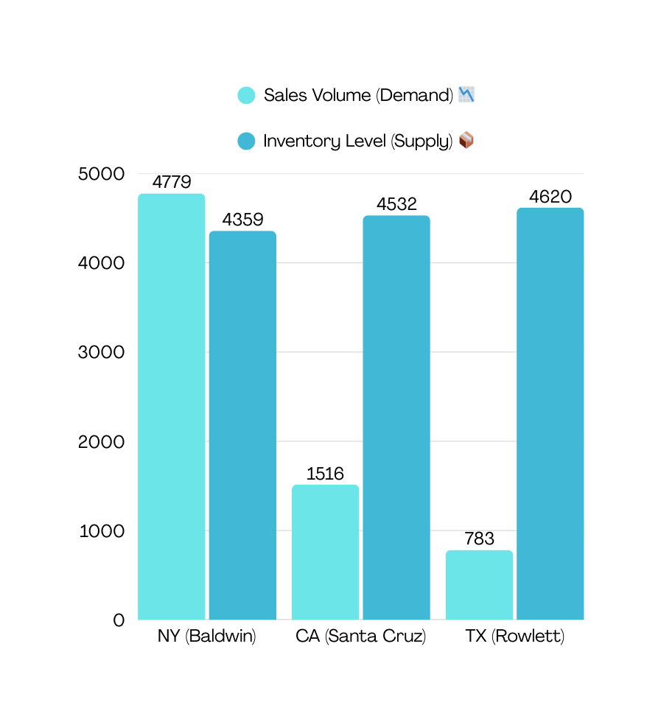
QUESTION 1: HOW DOES INVENTORY SUFFICIENCY CORRELATE WITH REGIONAL SALES PERFORMANCE?
Target Stakeholder:
🗺️ Regional Supply Chain Manager
The Statistic:
  New York (Baldwin Store) generates the highest demand (4,779 units sold) but holds the lowest inventory (4,359 units).
  In contrast, Texas sells only 783 units but hoards 4,620 units of stock.
The Action:
  Immediate: Initiate an Inter-Store Transfer to move 1,000 units from the Texas warehouse to the New York store.
  Long-term: Adjust the automated replenishment logic to allocate stock based on sales velocity rather than equal distribution.

Slide 7
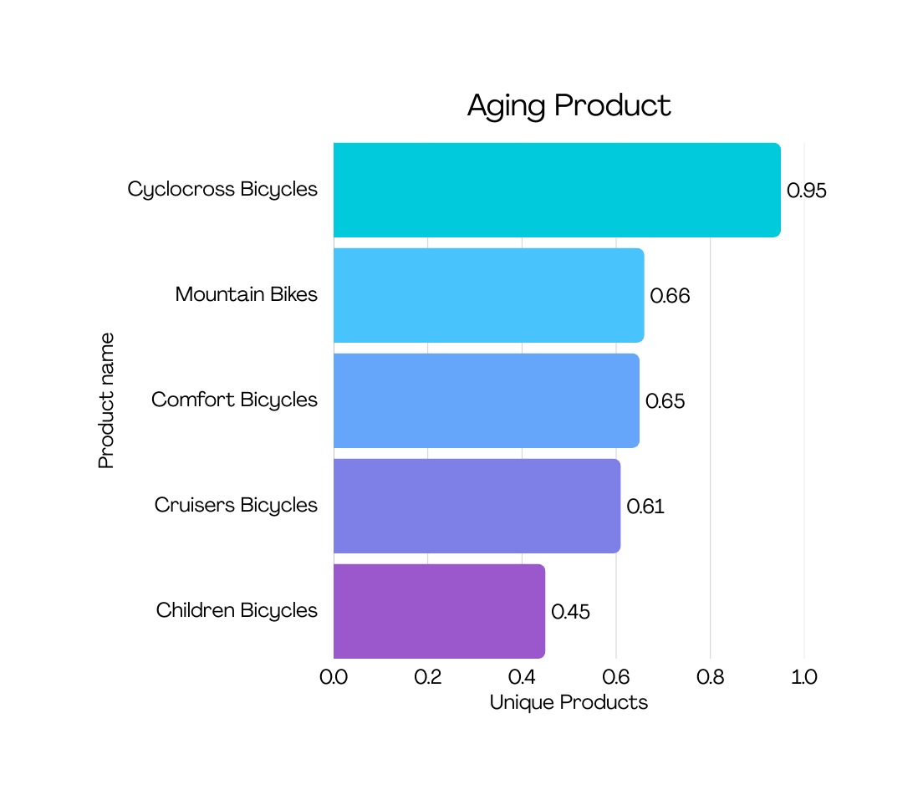
QUESTION 2: WHICH PRODUCTS FACE THE HIGHEST RISK OF "STOCKOUT"?
Target Stakeholder:
🏪 Store Operations Lead
The Statistic:
  Cyclocross Bicycles have a Risk Ratio of 0.95, meaning for every 100 bikes in stock, 95 are sold immediately.
  This is dangerously close to 1.0 (Zero Stock).
The Action:
  Safety Stock: Increase the minimum "Safety Stock" threshold for this specific category by 20% to buffer against demand spikes.

Slide 8
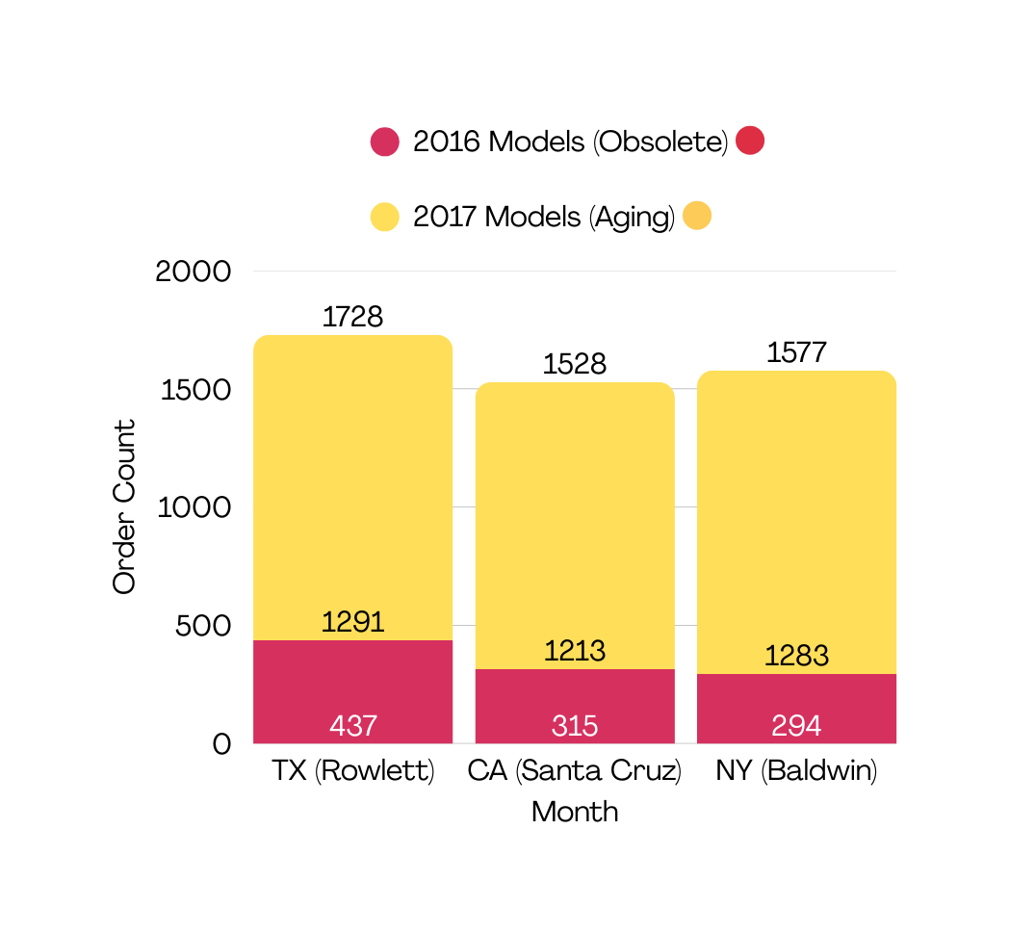
QUESTION 3: WHAT IS THE VOLUME OF "AGING INVENTORY" ACROSS REGIONS?
Target Stakeholder:
👔 Chief Operating Officer
The Statistic:
  The company is holding 1,046 units of obsolete 2016 models.
  Texas (Rowlett) is the worst offender, holding 437 of these obsolete units despite having the lowest foot traffic.
The Action:
  Liquidation Event: Launch a targeted "Texan Clearance Sale" offering aggressive 30-40% discounts on 2016 models specifically in the Rowlett store to convert this dead stock into cash.

Slide 9
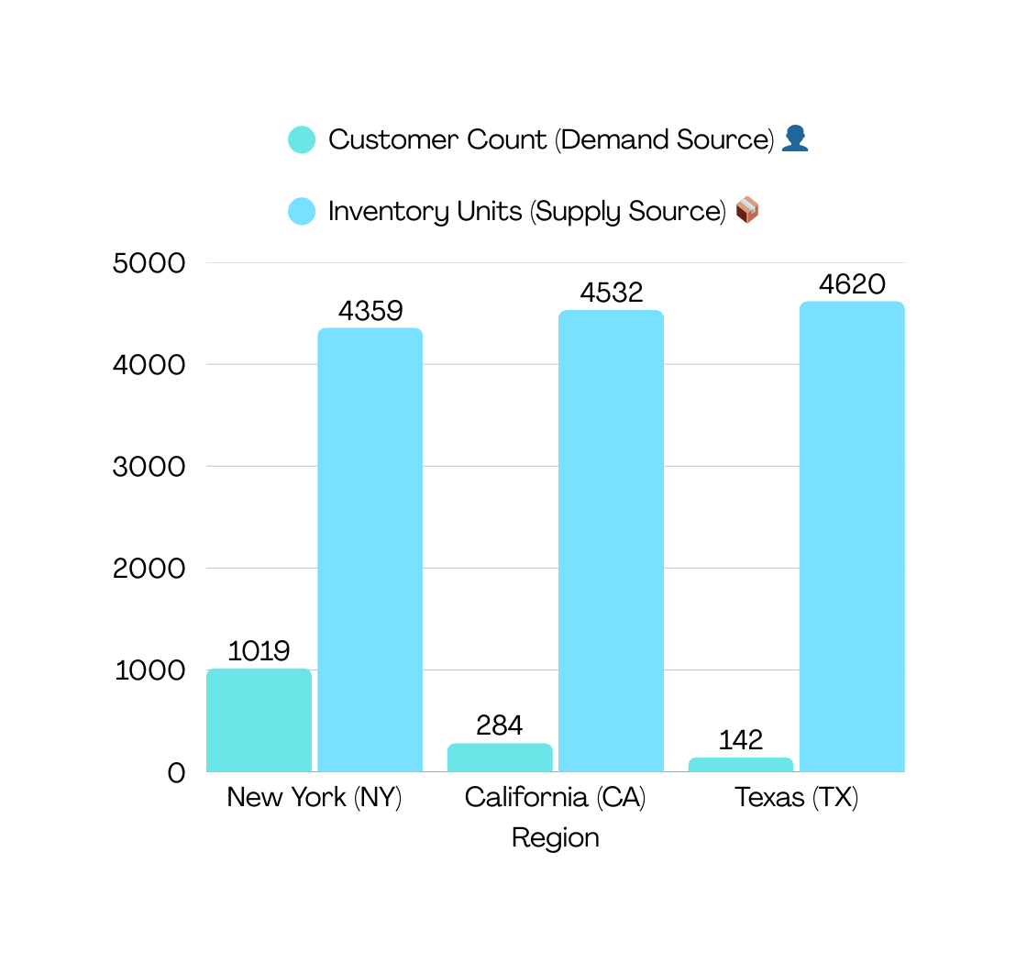
QUESTION 4: HOW ARE HIGH-VALUE CUSTOMERS DISTRIBUTED VS. INVENTORY?
Target Stakeholder:
🗺️ Regional Supply Chain Manager
The Statistic:
  70% of the entire customer base lives in New York (1,019 customers).
  However, the New York store holds less than 33% of the total company inventory.
The Action:
  Strategic Realignment: The Supply Chain network is unbalanced. We must prioritize the New York Hub as the "Primary Distribution Center", ensuring it always receives 60-70% of inbound shipments from manufacturers to match the customer density.

Slide 10
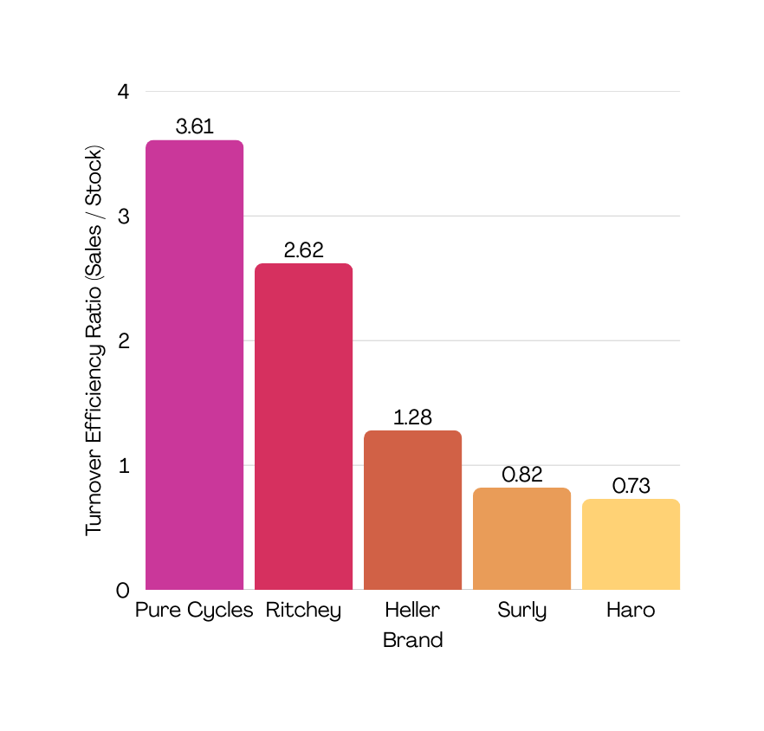
QUESTION 5: WHICH BRANDS DEMONSTRATE THE HIGHEST "TURNOVER EFFICIENCY"?
Target Stakeholder:
👔 Chief Operations Officer
The Statistic:
  Pure Cycles is an efficiency star with a turnover of 3.6x (sales far exceed standing stock).
  Surly is a laggard with a turnover of 0.82x (more stock sitting than selling).
The Action:
  Shelf Space Optimization: Double the shelf space allocated to Pure Cycles to capture more revenue.
  Renegotiate: Reduce future orders for Surly products or negotiate "Return-to-Vendor" agreements for unsold inventory to free up warehouse space.

Slide 11
WHAT ARE MY RECOMMENDATION?
Short-Term Wins (Next 30 Days)
Long-Term Strategy (Next 6-12 Months)
🚀 Immediate Inventory Rebalancing
  Transfer some of the units from TX (Overstocked) to NY (Stockouts) to capture immediate sales.
💸 Liquidate "Dead Stock"
  Launch a clearance sale on 2016 models in Texas to unlock so as to clear stock while earning profit
🧠 Data-Driven Procurement Model
  Maximizes shelf space and prevents future accumulation of stagnant inventory.
📍 Network Redesign
  Designate New York as the Primary Hub the high customer density.

Slide 12

THANK YOU

